Slide 1

Martingale Protocol(V1)

Slide 2
Protocol Structure
Martingale
Protocol
Frontend
On Chain
(Smart Contract)
Off chain
(Service)

Slide 3
Model Ⅰ——Mint/Burn
ERC20
Tokenized
Asset
Underlying
Asset
Mint/Burn
ERC1155
ERC20
L Token
S Token
AMM
(S+U)
U
Liquidation
Oracle
Protocol

Slide 4
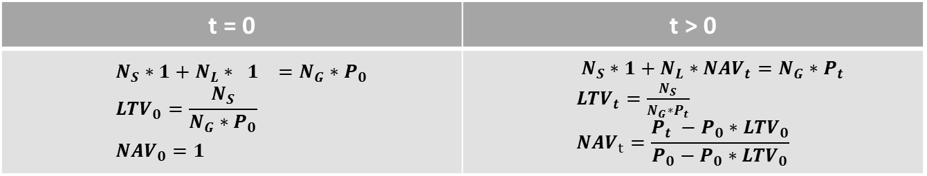

Model Ⅰ——Mint/Burn
Parameters：${LTV}_{max}=75\%$, $Liquidation= {LTV}_{max}+x\%$
Mint：Stake $N_{G}$ Underlying ➔ Mint $N_{S}$ stable token + $N_{L}$ leverage token
Burn： Users can burn minted assets in any proportion to redeem the underlying assets.
t = 0 | t > 0
$$N_{S}∗1+N_{L}∗ 1 =N_{G}∗P_{0}$$ $${LTV}_{0}=\frac{N_{S}}{N_{G}∗P_{0}}$$ ${NAV}_{0}=1$ | $N_{S}∗1+N_{L}∗{NAV}_{t}=N_{G}∗P_{t}$ ${LTV}_{t}=\frac{N_{S}}{N_{G}∗P_{t}}$ $${NAV}_{t}=\frac{P_{t} −P_{0}∗{LTV}_{0}}{P_{0}−P_{0}∗{LTV}_{0}}$$

Slide 5
Model Ⅱ——Interest Rate Model
Protocol
User
Tokenized Asset←→ S & L
TrancheVault
Underlying Asset
Tokenized Asset
U ←→ S
AMM(U+S)
Underlying token issuer
First lending: Lend out physical gold to receive tokens and earn interest.
Second lending: Pledge tokens to borrow USDT and pay interest.

Slide 6
Model Ⅱ——Interest Rate Model
Collateralize Tokenized Asset→Borrow U
Users pay interest to protocol
Model:
Gross Borrow Rate = Base Rate + Utilization Factor + Collateral Risk Premium
Base Rate: Lending interest rate for USD (U)
Utilization Factor: The fewer U in the AMM, the higher the factor
Collateral Risk Premium: Risk premium of the underlying asset
Practical:
Interest is accrued on a per‑second basis and reflected in the net value of L tokens.
Upon burning, the deduction is made once in the form of the underlying asset

Slide 7
Model Ⅱ——Interest Rate Model
Smart Contract
Lazy Evaluation + Global Index

Slide 8
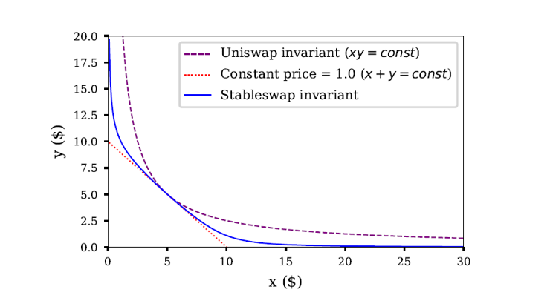
Model Ⅲ——AMM
AMM:
S token + U
Stableswap invariant
Arbitrage:
Use an arbitrage program to monitor AMM deviations.

Slide 9
Model Ⅳ——Oracle
Third-party oracles
Chainlink
Pyth Network
RedStone
Core features:
Delayed price updates
Multi-source aggregation
Multi-signature voting mechanism
Emergency halt
Price change threshold

Slide 10
Model Ⅴ——Liquidation
Keeper
User L token
①Bark
②
②
Remaining
Tokenized gold
② reward
Burn L token
Burn S token
reset
Penalty
Custodian
Auction
Bidder
④
③Buy tokenized gold
S token
③Pay S token
NOTE: The liquidation model determines the optimal liquidation boundary based on system parameters for users.

Slide 11
Mechanism
On-chain
Access Control / Multi-sig
TimeLock
Proxy Pattern
……
Off-chain
Liquidation bots
maintenance bots
arbitrage programs
……

Slide 12
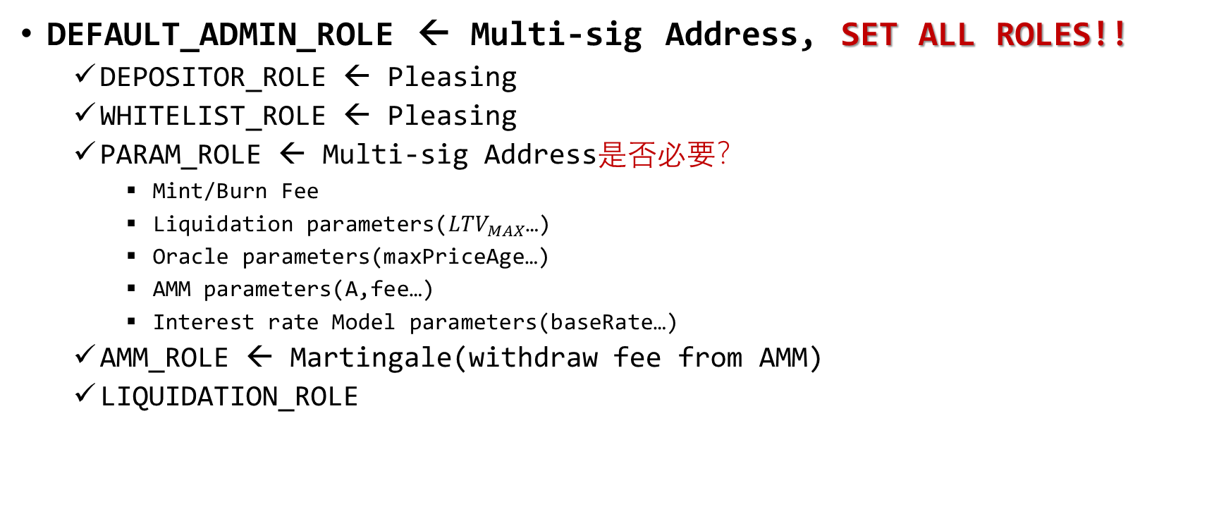
Mechanism——Access Control
DEFAULT_ADMIN_ROLE ← Multi-sig Address, SET ALL ROLES!!
DEPOSITOR_ROLE ← Pleasing
WHITELIST_ROLE ← Pleasing
PARAM_ROLE ← Multi-sig Address是否必要？
Mint/Burn Fee
Liquidation parameters(${LTV}_{MAX}$…)
Oracle parameters(maxPriceAge…)
AMM parameters(A,fee…)
Interest rate Model parameters(baseRate…)
AMM_ROLE ← Martingale(withdraw fee from AMM)
LIQUIDATION_ROLE

Slide 13
Mechanism——Whitelist
Variable
mapping(address => bool) public isWhitelisted; → store white address
Function
addToWhitelist
removeFromWhitelist
Restructions
require(isWhitelisted[receiver], "Receiver not in whitelist")
Note: only addresses in whitelist can mint

Slide 14
Mechanism——Finite State Machine(FSM)
State
Inception → Configuration phase
Set fee/whitelist…
Trading → Operational phase
mint/burn/swap
Paused → Crisis management phase
Stop minting/burning
Matured → Settlement/Termination phase

Slide 15
Smart Contract
TrancheVault: Core minting and burn function
previewMint/Mint(can be called by router)
previewBurn/Burn(only called by user)
getLeverageTokenInfo
Treasury: Store underlying assets
FeeTreasury: Store all protocol income
Mint/Burn fee ← underlying
AMM swap fee ← USDC/S
Accumulated Interest ← underlying
Underlying yield ← underlying

Slide 16
Smart Contract
Tokens
StableToken
LeverageToken
LPToken

Slide 17
Website
Martingale: https://martingaleco.com
App Demo: https://test-al2.pages.dev/app
Documentation: https://test2026.gitbook.io/test-tranche_protocol/fMFG0viXW9hbW0MeCbeh/

Slide 18
智能合約(規範,架構,部署)
智能合約順序
Using → enum → constant variable → immutable variable→ general variable → mapping → event → modifier → external functions → internal functions → view functions
模組化設計
對核心資產、不可變的依賴使用構造函數 + immutable. 如Stoken, Ltoken；
對 OracleManager、 InterestManager、 LiquidationManager 和 AuctionManager 這類邏輯模組，因為 DeFi 經常需要更新預言機和清算機制，推薦使用 腳本通過 Setter 函數進行設置（或者使用代理 Proxy 模式）。
treasury (國庫) 作為存放和管理資產的地方，在 DeFi 系統中通常強烈建議不要放在 Constructor 中寫死 (immutable)，而是透過 Setter 腳本進行設置；
盡量使用Interface
Interface: 低耦合；
Contract: 高耦合；

Slide 19
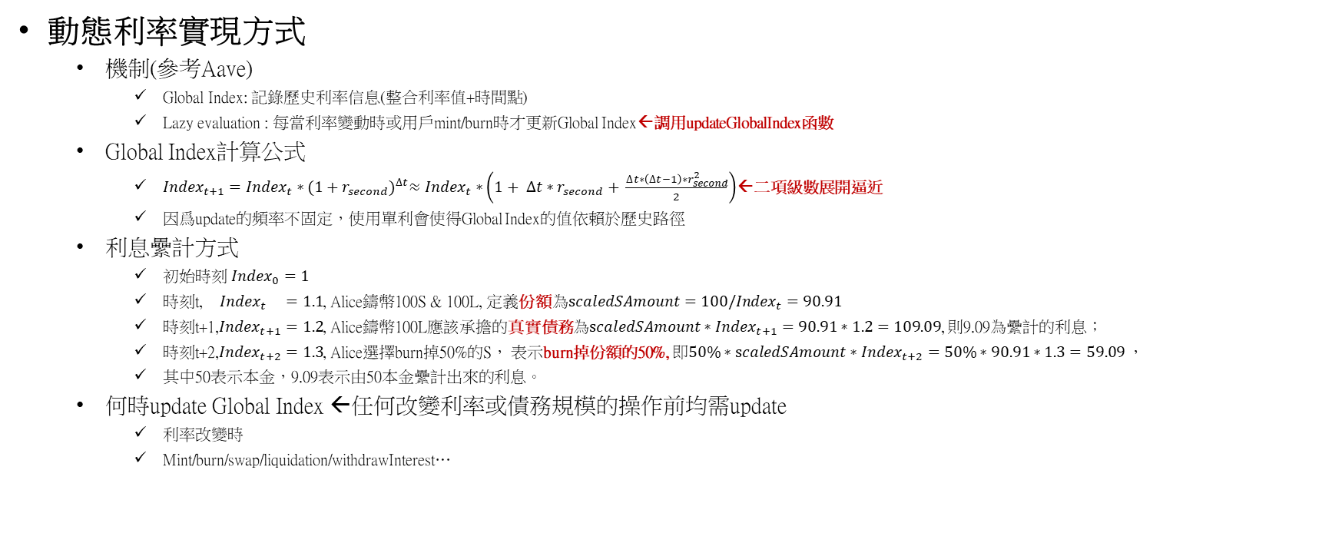
智能合約(規範,架構,部署)
動態利率實現方式
機制(參考Aave)
Global Index: 記錄歷史利率信息(整合利率值+時間點)
Lazy evaluation : 每當利率變動時或用戶mint/burn時才更新Global Index←調用updateGlobalIndex函數
Global Index計算公式
${Index}_{t+1}={Index}_{t}∗{(1+r_{second})}^{∆t}≈{Index}_{t}∗\left(1+ ∆t∗r_{second}+ \frac{∆t∗\left(∆t−1\right)∗r_{second}^{2}}{2}\right)$←二項級數展開逼近
因爲update的頻率不固定，使用單利會使得Global Index的值依賴於歷史路徑
利息纍計方式
初始時刻 ${Index}_{0}=1$
時刻t, ${Index}_{t} =1.1$, Alice鑄幣100S & 100L, 定義份額為${scaledSAmount=100/Index}_{t}=90.91$
時刻t+1,${Index}_{t+1}=1.2$, Alice鑄幣100L應該承擔的真實債務為${scaledSAmount∗Index}_{t+1}=90.91∗1.2=109.09$, 則9.09為纍計的利息；
時刻t+2,${Index}_{t+2}=1.3$, Alice選擇burn掉50%的S， 表示burn掉份額的50%, 即${50\%∗scaledSAmount∗Index}_{t+2}=50\%∗90.91∗1.3=59.09$，
其中50表示本金，9.09表示由50本金纍計出來的利息。
何時update Global Index ←任何改變利率或債務規模的操作前均需update
利率改變時
Mint/burn/swap/liquidation/withdrawInterest…

Slide 20
智能合約(規範,架構,部署)
Allowance/transfer機制
underlyingToken.allowance(msg.sender, address(this)) //執行者→當前合約的allowance
underlyingToken.safeTransferFrom(msg.sender, receiver, amount) //執行者→接收者的transfer

Slide 21
智能合約(規範,架構,部署)
Public/external

